Slide 1
Vehicle Price Prediction
2024 Capstone Project
By Mahlatsi Mashilo
202215639

Slide 2

Overview
The used car market in South Africa has become increasingly expensive and unpredictable, leaving buyers vulnerable to overpaying and sellers unsure of fair pricing.
This project harnesses the power of data science to build a real-time car price prediction tool. By analyzing key factors—such as brand, mileage, engine size, and vehicle age—the machine learning model provides accurate price forecasts.
Key Innovation
With an intuitive dashboard and interactive interface, users can effortlessly input vehicle details and receive instant, data-driven price estimates.

Slide 3
Table of contents
01
02
03
04
05
06
Problem Statement
Challenges & Objectives
Methodology
Process Flowchart and Data
Model Creation and Implementation
Conclusion and Future Work

Slide 4
01
Problem Statement

Slide 5

Problem Statement
New car prices in South Africa have skyrocketed, with over 70% now priced above R500,000 (Lückhoff, 2024), while the national minimum wage has only increased by 8.5%(Davis, 2024). This has driven most South Africans toward the used car market, where pricing remains volatile and often inaccurate.
To address this, the project leverages data science techniques to predict used car prices in real time. By analyzing factors like brand, mileage, engine size, and vehicle age, we empower buyers to make informed decisions and help sellers set competitive, fair prices.

Slide 6
02
Problem & Objective

Slide 7
Challenges in the Used Market
Volatility
Risk to Customers
The South African used car market is characterized by volatility, where buyers often encounter unrealistic deals from salesmen eager to make a sale.
Many potential buyers risk falling into interest rate traps or purchasing vehicles with hidden mechanical issues. This uncertainty not only jeopardizes their finances but also undermines trust in the market.

Slide 8
Objectives
Best Model
Identify the most effective machine learning model for car price prediction
Prediction Accuracy
Improve prediction accuracy by reducing model errors as much as possible.
Scalability and Efficiency
Enhance scalability and efficiency to handle large datasets, ensuring optimal performance for real-time price predictions.

Slide 9
03
Methodology

Slide 10
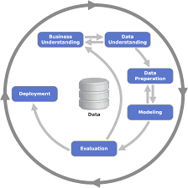
CRISP-DM
Business Understanding: identifying the root causes of inflated and unrealistic car prices in South Africa, setting the stage for a data-driven solution.
Data Understanding: analyzed the dataset from Kaggle to grasp how various features—like mileage and brand—impact car pricing.
Data Preparation: this phase involved rigorous data cleaning and normalization, as well as splitting the dataset into training and testing sets to ensure robust model performance.

Slide 11
CRISP-DM
Modeling: the utilization of multiple machine learning models, applying the pre-processed data to discover the most effective prediction strategies.
Evaluation: through evaluation metrics such as Mean Absolute Error (MAE), Mean Squared Error (MSE), and R², were used to assess model performance to identify the best one.
Deployment: Finally, the most effective model was implemented into an interactive interface, allowing users to input car features and receive real-time price predictions.

Slide 12
04
Process Flowchart

Slide 13
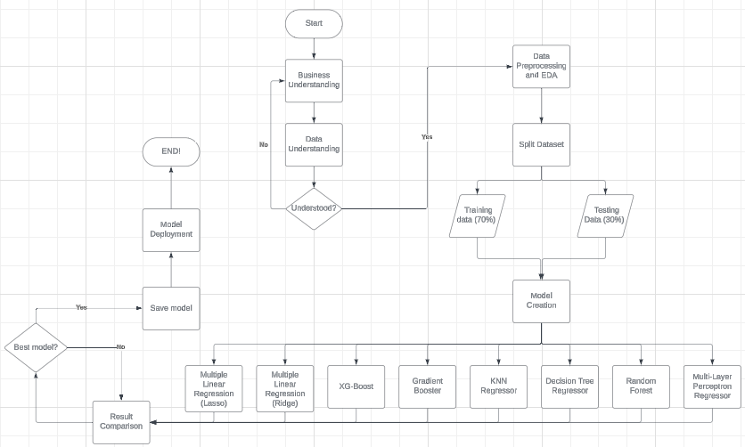

Slide 14
05
Dataset

Slide 15
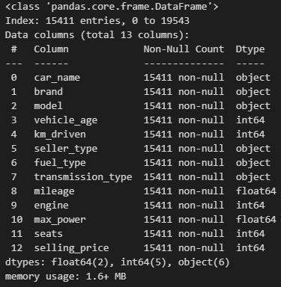
Data Description
Car Name - The specific name of the vehicle
Brand - The brand of the vehicle
Model - The specific model-name of the car
Vehicle Age - The year the vehicle was produced (yrs)
KM Driven - The number of kilometers the car has travelled (km)
Seller type - The type of seller the car is being sold by (Individual/Dealer/Trustmark Dealer)
Fuel Type - The fuel the car is using (Petrol/Diesel/CNG/LPG/Electric)

Slide 16
Data Description
Transmission Type - The type of gearbox the vehicle has (Automatic/Manual)
Mileage - The Fuel Economy of the car (kmpl)
Engine - The size of the engine (CC)
Max Power - The horsepower of the car after taking into consideration friction between car tires and the road (bhp)
Seats - The total seats in the car
Selling Price - The selling price of the vehicle (R1 = Rs. 0.20809)

Slide 17
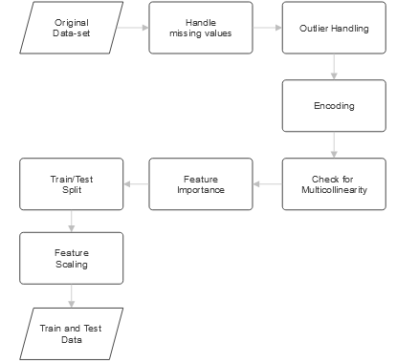
Data Preprocessing
Used One-Hot Encoding and the Ordinal encoder.
The max power and engine size columns were combined, and the fuel-type Diesel column was dropped to tackle multicollinearity.
The random forest regressor was used to test for feature importance.
A 70/30 split was used for the Train/Test split.

Slide 18
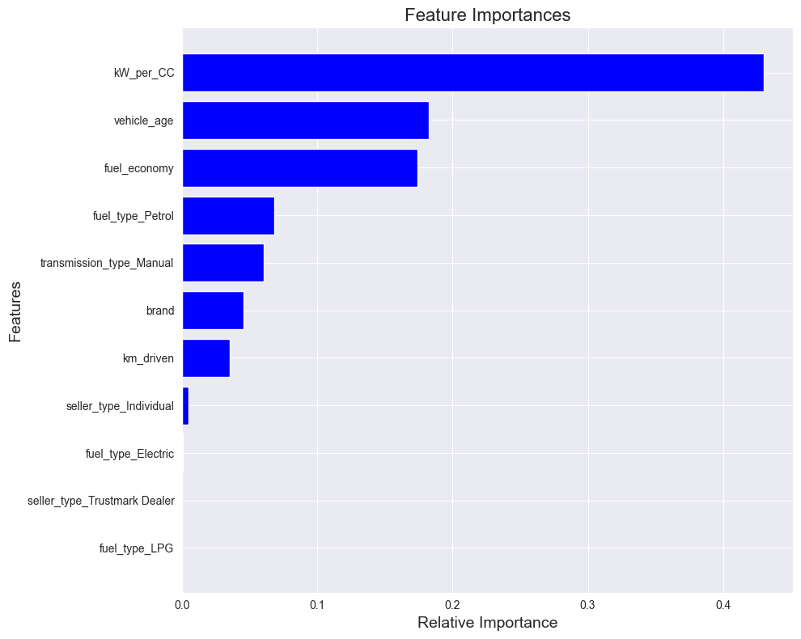
Feature Importance
KW_per_CC and vehicle age are the most significant factors influencing used car prices.
Fuel economy also plays an important role in price prediction.
Other factors i.e., fuel type and transmission are relevant but less critical.
Features like fuel type (electric, LPG) and seller type have little impact on the predictions.
All these observations took the number of features down to 8.

Slide 19
06
Model Results

Slide 20
Model Results
Model | R-Squared | MAPE | MAE | MSE | Negative MSE
Ridge | 0.781 | 28.135 | 28560.140 | 1.402904e+09 | Nan
Lasso | 0.781 | 28.136 | 28560.090 | 1.402902e+09 | Nan
Random Forest | 0.933 | 13.124 | 14294.710 | 4.296944e+08 | 4.303566e+08
XG-Boost | 0.938 | 12.665 | 13955.125 | 3.987113e+08 | 4.176474e+08

Slide 21
Model Results
Model | R-Squared | MAPE | MAE | MSE | Negative MSE
Gradient Booster | 0.934 | 12.925 | 14 396.354 | 4.229587e+08 | 4.303967e+08
KNN | 0.904 | 15.329 | 16 621.307 | 6.173680e+08 | 6.024265e+08
Decision Tree | 0.905 | 14.285 | 15 903.547 | 6.078733e+08 | 6.249561e+08
MLP | 0.865 | 18.143 | 21 199.334 | 8.676259e+08 | 8.120970e+08

Slide 22
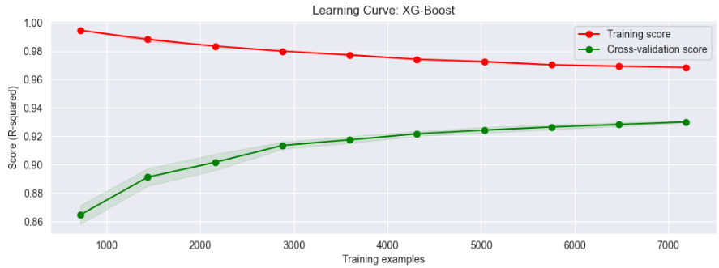
XG-Boost in Detail
Class of scalable ensemble machine learning algorithms that provide parallel tree boosting
The following are the Hyperparameters of the best model:
'subsample': 0.8
'reg_lambda': 2.0
'reg_alpha’: 0
'n_estimators': 300
'max_depth’: 7
'learning_rate': 0.05
'gamma’: 0
'colsample_bytree': 0.7

Slide 23
07
Web Application

Slide 24
08
Conclusion

Slide 25
Conclusion
Final Thought
Results
This project successfully developed an accurate machine learning model for used car price prediction in South Africa, offering valuable insights to buyers and sellers.
93.8%
12.6%
1.4e+04
R-squared score
MAPE score
MAE Score
Future Work
Integrate a feature that allows users to receive a breakdown of the predicted price based on the contributing factors.
Find a way to get a South African dataset to make predictions more accurate.
Key takeaway 1
XG-Boost is the best model for predicting used car prices in South Africa.
Key takeaway 2
Utilizing data from a similar market (India) proved to be a viable alternative due to unavailable South African data.

Slide 26
Thank You!
Any Questions? ☺

Slide 27
References
Baladram, S. (2024, October 01). Decision Tree Regressor, Explained: A Visual Guide with Code Examples. Retrieved from Towards Data Science.
Davis, H. (2024, February 6). Increase in the National Minimum Wage effective 1 March 2024 . Retrieved from Financial Institutions Legal Snapshot: https://www.financialinstitutionslegalsnapshot.com/2024/02/increase-in-the-national-minimum-wage-effective-1-march-2024/
Lückhoff, C. (2024). over-70-of-new-cars-in-south-africa-now-exceed-r500000. Retrieved April 17, 2024, from Autotrader: https://www.autotrader.co.za/cars/news-and-advice/automotive-news/over-70-of-new-cars-in-south-africa-now-exceed-r500000/14167
Appendix:
GitHub Repository

